Slide 1
TypeScript
Creating and Using Interfaces
Lecture 4
By James(Jin) Wang
11/15/2021

Slide 2
Outline
What is an interface?
Defining an interface
Using an interface
Interface vs Type

Slide 3
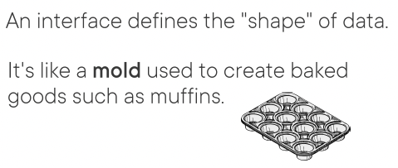
What is an interface

Slide 4
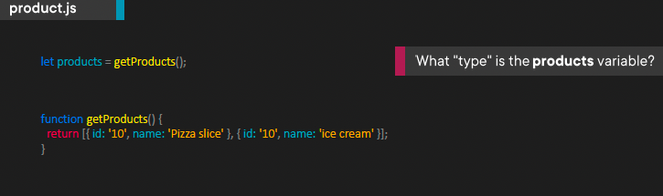
What is an interface
  The Case for Interfaces: What data am I getting?
  Discovering what type of object a function or property returns can be challenging in JavaScript.
  TypeScript interfaces can help in this scenario.

Slide 5
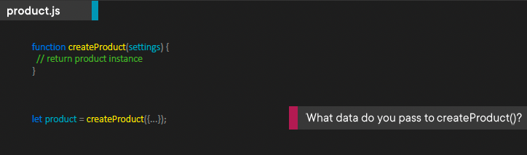
What is an interface
  The Case for Interfaces: What data do you pass?
  How do you know if you’re passing the correct data to a function?

Slide 6
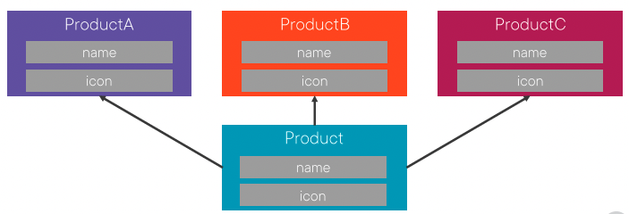
What is an interface
  The Case for Interfaces: Drive Consistency?

Slide 7
Defining an interface
  Demo: Define Interface

Slide 8
Using an interface
  Demo: Use Interface

Slide 9
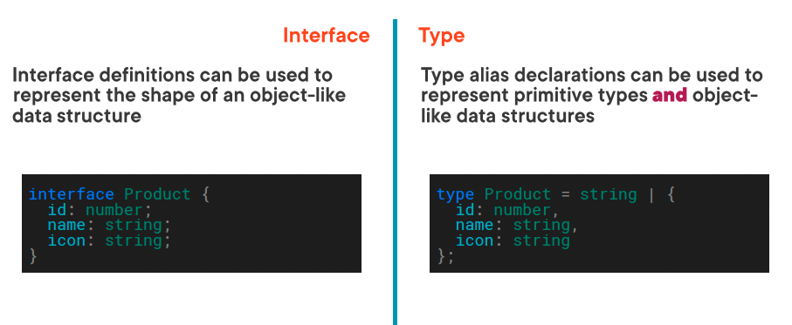
Interface vs Type

Slide 10
Interface vs Type
  Demo: Interface Type

Slide 11
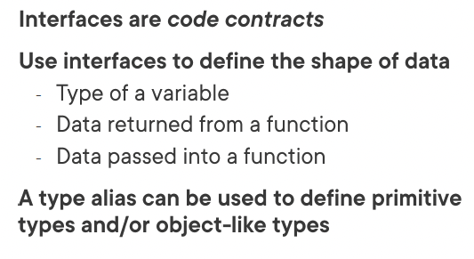
Summary

Slide 12
Assignment

Slide 13
Self Study
  Typescript Core Language Path
  TypeScript: Getting Started
  https://app.pluralsight.com/library/courses/getting-started-typescript
  TypeScript Fundamentals
  https://app.pluralsight.com/library/courses/typescript-fundamentals

